Slide 1

A Comparitive Study of Answer-contained Snippets and Traditional Snippets
Dan Wang
Beijing Institute of Technology
wangdan12856@sina.com

Slide 2
Outline
Background
Answer-contained Snippet
Experiments and Results
Conclusion

Slide 3













Background
Questions
Answers
Information Seekers
Search Engines and cQA Sites
Problem: ambiguity

Slide 4



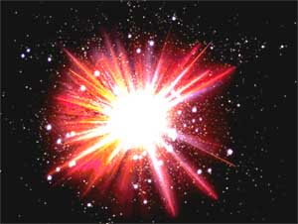

Ambiguity
Query：Apple
Apple Inc.
Fruit
Question：what is big bang？
the band named “big bang”
the TV play named “big bang”
“big bang theory”
Solution: Snippet
Notes:
The queries we submit to search engines are often inherently ambiguous. For example, here is a query :”What is big bang?”。。。

Slide 5
Traditional Snippet
Relevance judgment
compensate for the inaccuracy of ranking functions
relevance between document and query
Criteria for evaluating search engines

Slide 6
Snippet Generation
Static and query-independent snippets
[Edmundson et al., ACM,1969]
Eﬃcient but often ineﬀective.
Query-biased snippet
[Tombros et al., ACM, 1998] [Turpin et al., SIGIR, 2007]
Unable to process structural or semi-structural data
Structural snippets
[Huang et al., ACM, 2008] [Liu et al.,SIGMOD, 2007]
XML documents but not for cQA data
Notes:
Early works generated static and query-independent snippets, consisting of the first several sentences of the returned document.
Generally, there are two kinds of sentence selection methods in query-based snippet generation.
One is heuristic method, sentences are choosed by importance. For example, if a sentence is the first sentence of paragraph, it may be more important than others.
The other is machine learning method.
Recently, structural snippets have been explored for XML documents

Slide 7

cQA Document
Google: “How to lose weight? Site: answers.yahoo.com”
Yahoo! Answers: “How to lose weight?”
Weakness:
No snippet generation methods designed for cQA data
Answer not contained in snippets
Notes:
To fix the inaccuracy of ranking functions, snippets are used to reflect the relevance between a document and a query.
Almost every text search engines use snippets to help users quickly assess the relevance of retrieved items in the ranked list.
Example…
If the snippet for a highly relevant document is poorly generated, the user may perceive the document as non-relevant and does not click on the document.

Slide 8
Answer-contained Snippet
Relevance：
Reflect the relevance between document and query
Satisfaction：
Contain sentences to satisfy the information need
Aim: No more clicks! [One Click Access Task of NTCIR]
Challenges：
How to rank answers？
What if the size of one answer is large？
Notes:
improve the user-friendliness and eﬀectiveness

Slide 9
Outline
Background
Answer-contained Snippet
Experiments and Results
Conclusion

Slide 10
Answer Importance
Best Answer Importance
Vote Number Importance
Authority Importance
Notes:
How to rank answers?
First, people could take Best Answer chosed by asker or by cQA system in a cQA document as the highest quality answer.
Second, because the vote number reflects the answers’ popularity, the answer with the largest vote number could be thought as the highest quality answer among answers.
At last, the authority of user reflect the reliability of answer submitted by the user, thus the answer submitted by the highest authority user could be taken as the highest quality answer.

Slide 11
Answer Importance
We combined all these 3 factors together using linear combination：
Set

Slide 12
Size Consideration
Table 1. Statistics of the length (in words) of the question bodies (QBody), the Best Answers (BAns) and All Answers (AAns).
Words | <30 | <50 | <100 | <150 | <250 | <350
QBody | 0.5011 | 0.6819 | 0.8935 | 0.9584 | 0.9964 | 0.9986
BAns | 0.3653 | 0.5476 | 0.7908 | 0.8883 | 0.9565 | 0.9776
AAns | 0.5191 | 0.6965 | 0.8841 | 0.9445 | 0.9804 | 0.9902
Choose 200 words to cover 96.8% answers.
Notes:
how to provide as much information as possible in a snippet within an moderate size.

Slide 13
Outline
Background
Answer-contained Snippet
Experiments and Results
Conclusion

Slide 14
Dataset
Yahoo! Answers
https://answers.yahoo.com/
Computer & Internet, Health
6,345,786 question and answer pairs
[question title, question body, best answer, other answers, metadata.]
Notes:
Although it is difficult to achieve satisfaction for general search, it is relatively easier for cQA search, since a question in a cQA document has corresponding answers.

Slide 15
Baseline
Gradient boosted decision tree (Metzler et al., SIGIR, 2008)
Feature: Exact match of query, overlap proportion, overlap-syn proportion, sentence language model, sentence length, sentence location.
Trainset: 10 queries, corresponding top 20 retrieved documents.
Summarization: Extracting sentences manually.
Technology: GBM package for R
http://cran.r-project.org/web/packages/gbm/
Notes:
The state-of-the-art snippet generation method proposed by Metzler was chosen as our baseline algorithms,.
It uses gradient boosted decision tree (GBDTs) learning approach for the snippet generation task.
Extracting sentences according to corresponding queries manually.
The number of sentences for a summary is recommended to be ﬁve. However, if there are more or less appropriate sentences, they could be selected in spite of the recommendation.

Slide 16
Evaluate Scheme
Settings:
50 queries, top 30 retrieved relevant documents as groundtruth.
2 groups, 10 evaluators.
Actions: move through the list or to click the full text.
Goal: identify as more relevant documents as possible in 2 minutes.
Recall, Precision and F₁
Speed
Reference to the full text of the documents
Opinions of users
Notes:
//The 50 queries (questions) used in two experimental procedures were sampled from the questions in our dataset; meanwhile, top 30 retrieved documents of each query were manually judged to be relevant or not, as our groundtruth.

Slide 17
Retrieval Model
Similar to the ranking function by Xue et al. (Xue et al., SIGIR, 2008)
Difference: Jelinek-Mercer smoothing instead of Dirichlet Smoothing
statistical word translation model (Delphine et al., ACL, 2009 )
Set

Slide 18
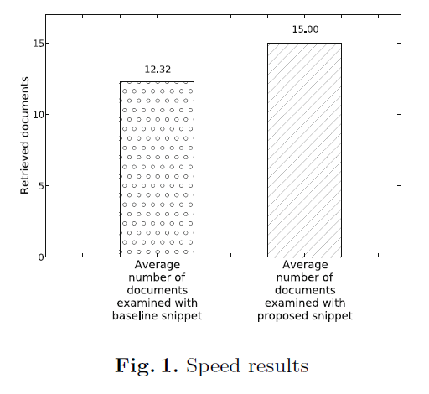
Results on Relevance
Recall, Precision and F1
Speed
Table 2. The P, R, F1 Value of the Two Groups
 | Precision | Recall | F1
Baseline | 0.5944 | 0.4676 | 0.5234
Proposed | 0.7969 | 0.5306 | 0.6370
20.25%, 6.3% and 11.36%
21.75% increase
Notes:
The performance diﬀerence is 20.25%, 6.3% and 11.36%.
It shows that users in the ’proposed snippet group’ managed to successfully and accurately identify a larger number of relevant documents than the other group.
2 minute
evaluators using the proposed snippet examined on average 15 documents per query, while evaluators using baseline snippet examined on average 12.32 documents. It amounts to a 21.75% increase in the average number of documents examined.

Slide 19
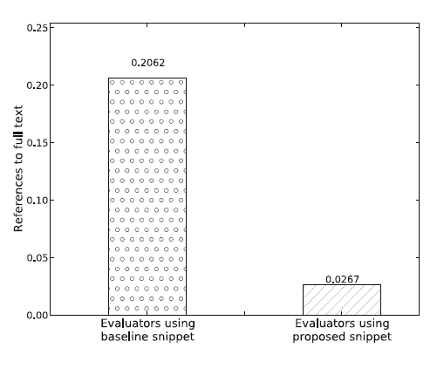
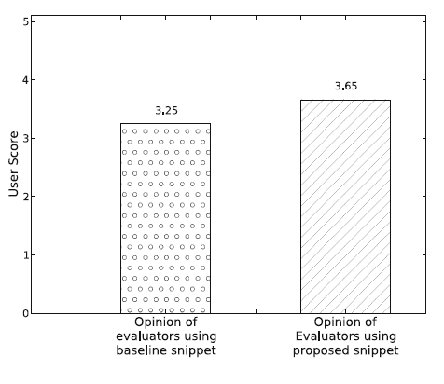
Results on Relevance
Reference to the full documents
Opinions of users
Need less clues
Notes:
Users need less clues to establish the relevance of documents, and especially they need clues about the context by which the question-type query are generated.
If these clues are not provided from snippet, users refer to the full text of the documents.
Our results shows the proposed snippet provided the evaluators with enough evidence to support their relevance judgements.
The data shown in this ﬁgure indicates that evaluators using baseline snippet rated on average the utility of the accompanying information at 3.25, while evaluators assigned in the other task indicated a rating of 3.65.

Slide 20
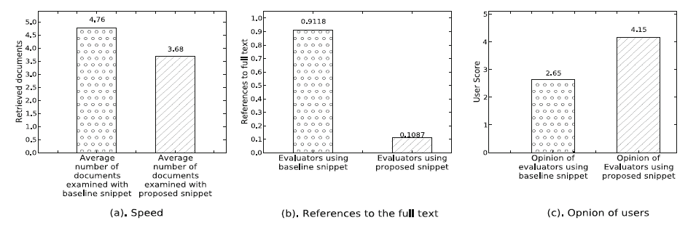
Results of Satisfaction

Slide 21
Outline
Background
Answer-contained Snippet
Experiments and Results
Conclusion

Slide 22
Conclusion
Comparative study on answer-contained snippets and traditional snippets.
A simple answer-contained snippet generating function that can help users judge relevance quickly and satisfy information need fast.
The results show that it’s promising research direction to contain answer in a snippet in future.

Slide 23
Thanks for Attention

